Slide 1
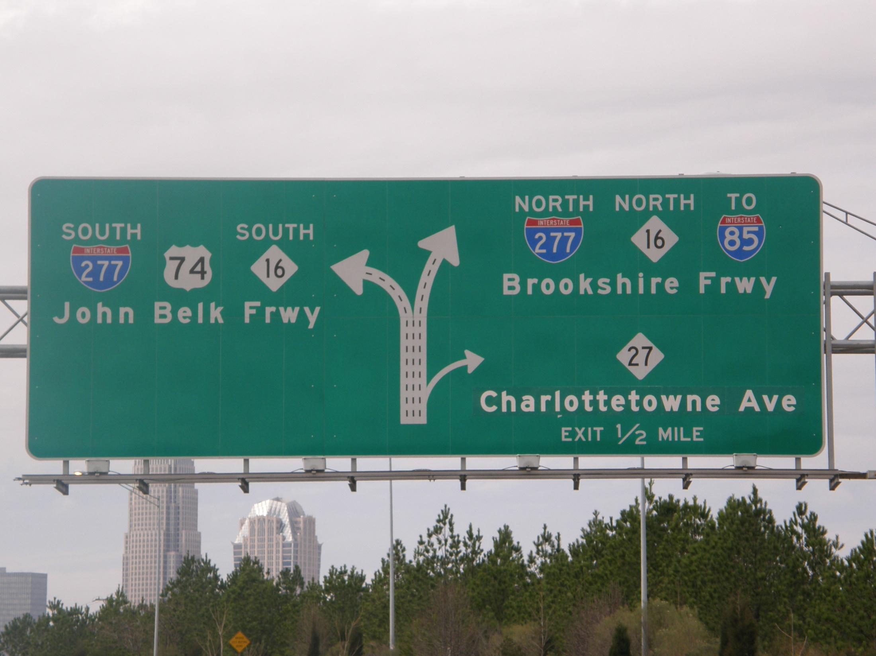
Independence Blvd. (Hwy 74 West)
Toward downtown Charlotte
Prepare to exit right (exit 243) Charlottetowne Ave.

Slide 2
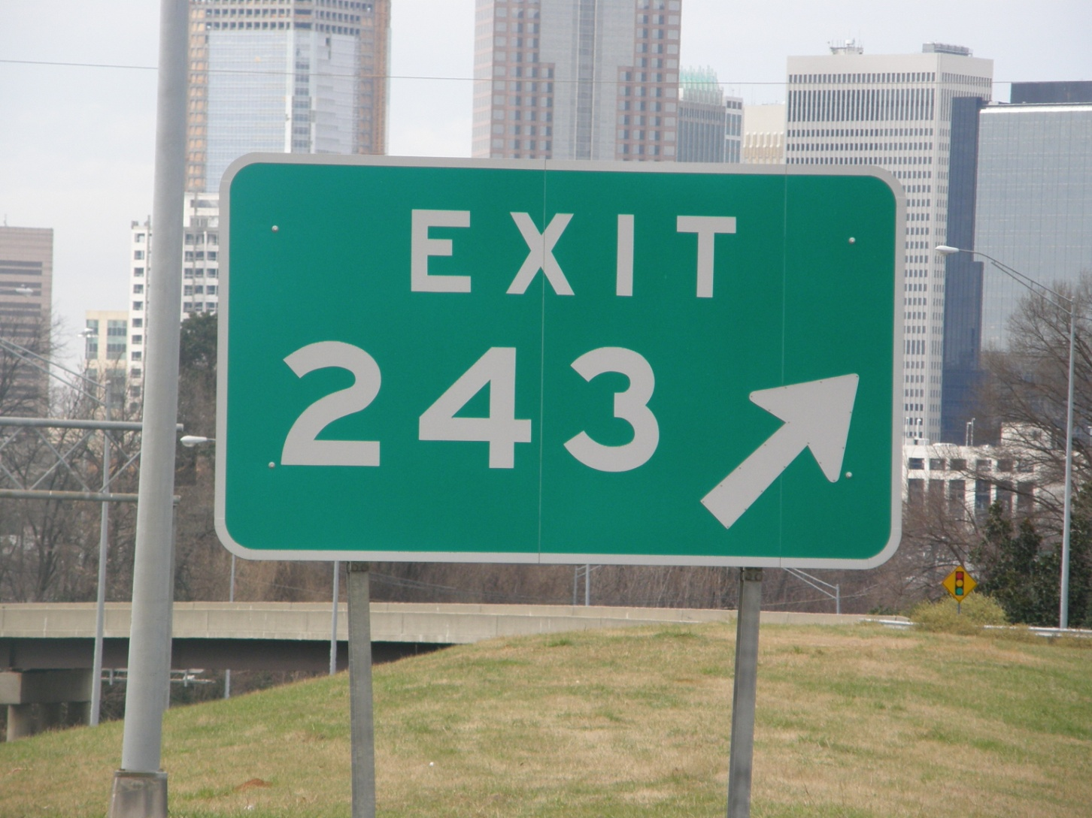
Bear right at Exit 243 (Charlottetowne Ave)
toward Memorial Stadium & CPCC

Slide 3
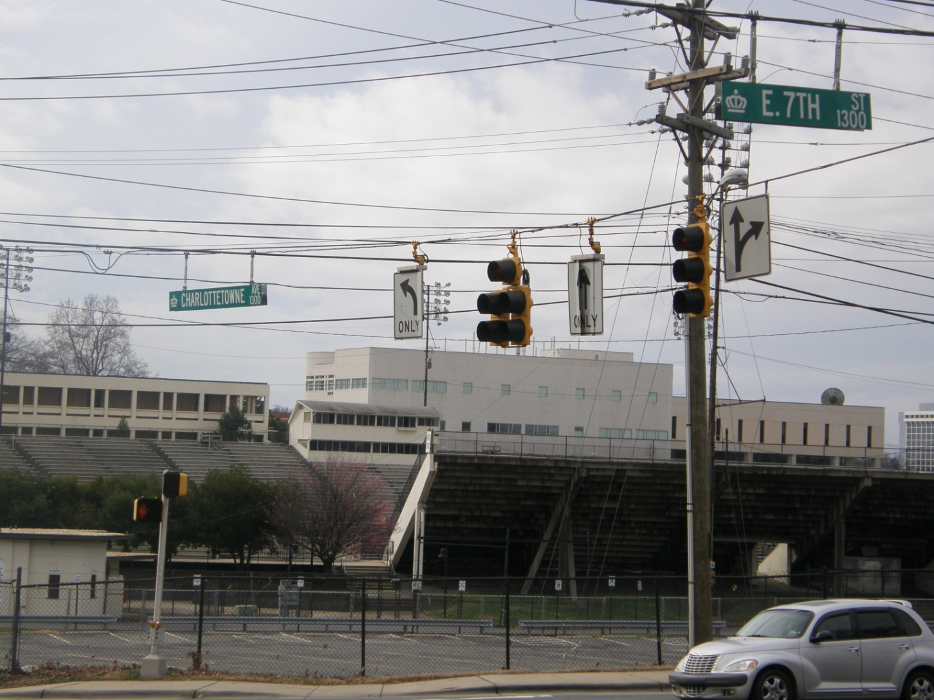
↓ CPCC
↓ Memorial Stadium
After exit stay in left lane.
First intersection is 7th Street & Charlottetowne Ave.
Make a U turn at this light, returning to Independence Blvd.

Slide 4
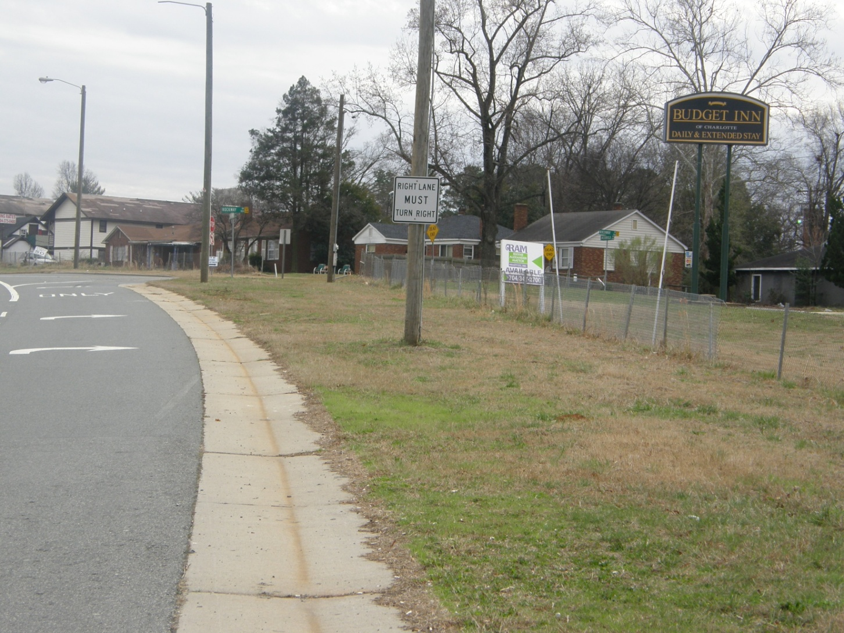
Exit for ↑
Rockway Drive
Travel 1.3 miles to the first road on your right,
and turn right onto Rockway Drive.
This street is the entrance for Budget Inn. (see next picture)

Slide 5
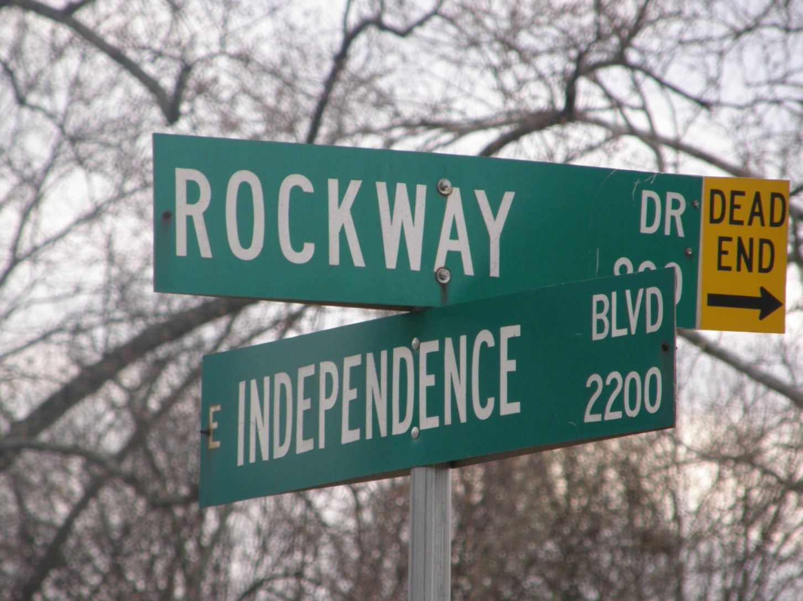
This is the intersection of Rockway Drive & East Independence Blvd. Turn right onto Rockway and then turn right onto Chesterfield. Lamp Light Church is located directly behind Budget Inn.
(see next picture)

Slide 6
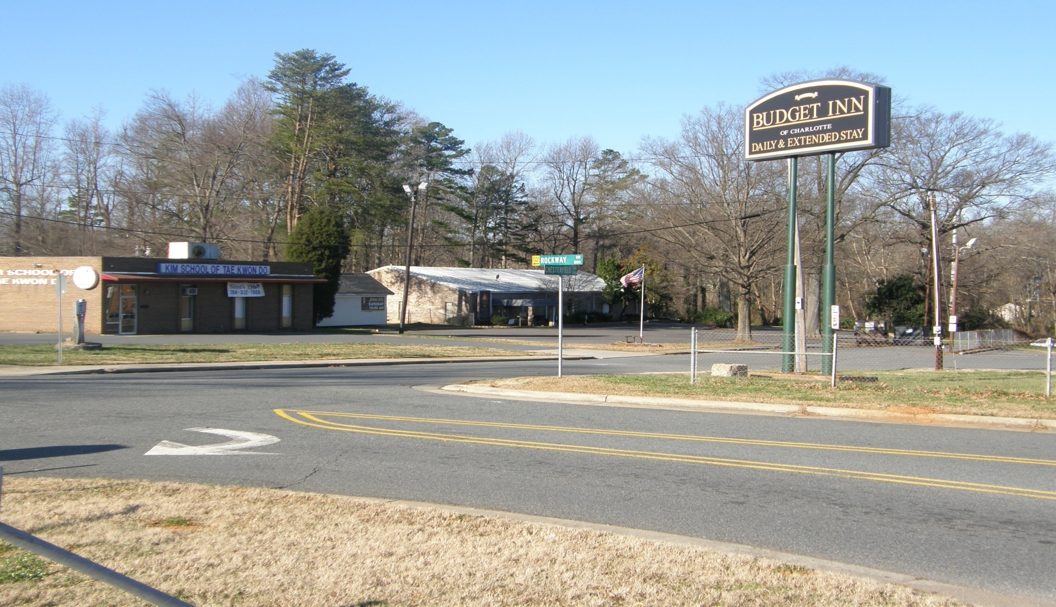
Lamp Light
↓ Church
↓ Kim School
↘
Chesterfield Ave. ↑
Rockway Drive off ↑ Independence Blvd. →
Lamp Light Church
2726 Chesterfield Ave
Charlotte NC 28205
704-375-7636

